Slide 1
Essentials Edition
N.N.
NN@qt.qio
February 2017 – Based on Qt 5.9

Slide 2
Contents
Qt Essentials | Qt 5 Modules, Creating, Building, and Debugging Applications with QtCreator, Logging Messages, Asserts, Practical Tips for Developers
Objects in Qt | QObjects vs. Value Types, Memory Management, Qt Smart Pointers, Meta-Object System, Signals and Slots, Properties
Meta-Type System | Variants, Custom Types and Variants
Event Handling | Events, Basic Event Handling, Event Loop, Event Dispatching, Custom Events, Event Filters
Core Classes | String Handling, Item Containers, File Handling, Data Streams and Serialization

Slide 3
Objectives
To get a good practical experience on
Qt basics
Qt objects
Event handling
Core classes
To be able to start serious Qt development or continue efficient Qt development after the training
Any questions at any point – please do not hesitate to ask!

Slide 4
Qt Essentials

Slide 5
Contents
Qt 5 Modules
Creating, Building, and Debugging Applications with QtCreator
Logging Messages, Asserts
Practical Tips for Developers

Slide 6

The Qt Company: A Brief Introduction
http://www.qt.io
Responsible for all Qt operations globally
Worldwide leader in
Qt API development
Qt Application Development
Design services – UI and UX
Trusted by over 8,000 customers worldwide
20+ years of Qt experience
200 in-house Qt experts
Fast growing
32M€ revenue in year 2016

Slide 7
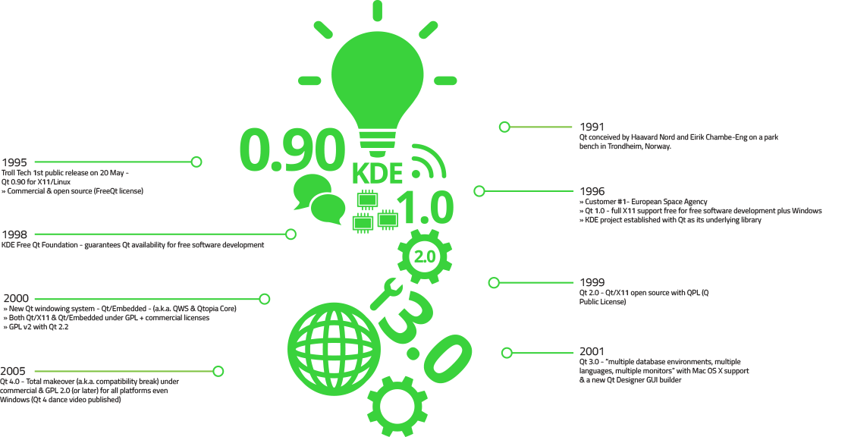
Qt History

Slide 8
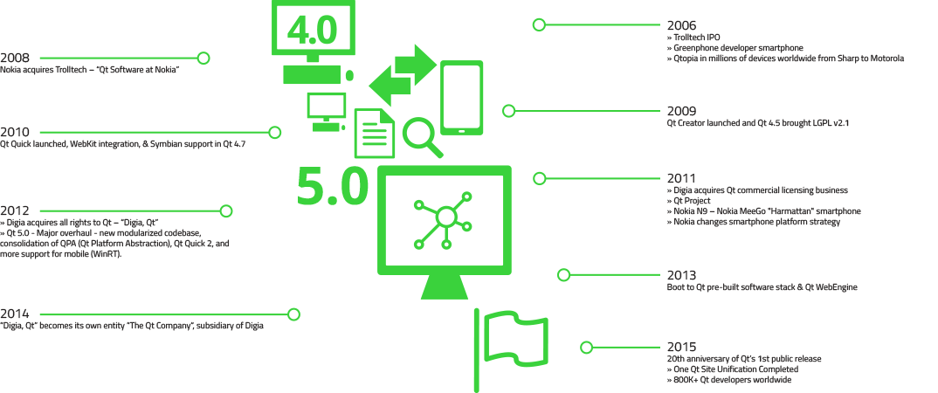
Qt History

Slide 9



The Leading C++ Cross-Platform Framework
Cross-Platform
Class Library
One Technology for All Platforms
Integrated
Development Tools
Shorter Time-to-Market
Cross-Platform
IDE, Qt Creator
Productive development environment
Used by over 1 million developers in 70+ industries
Proven & tested technology – since 1994
Notes:
Using Qt, you can write applications once and deploy them across many desktop and embedded operating systems without rewriting the source code.
Qt is a cross-platform application and UI framework, consisting of a:
Cross-platform class library. This is the core part of the product: hundreds of pre-made C++ classes that the developer uses to build his applications. The driving for of Qt has always been in the GUI capabilities, but Qt provides cross-platform code modules extensively for the other parts of the application as well.
Integrated development tools. Qt comes with some build tools that enable the cross-platform transition but Qt always uses a native OS compiler. So, we do not ship our own compilers or debuggers but hook into them with our own tools. Also, we provide a lot of tooling to ease the general time-to-market, especially for device creators.
Cross-platform integrated development environment, namely Qt Creator. Qt Creator is a magnificent tool for writing Qt applications. Besides making Qt development easy it also provides tooling for graphical UI design, profiling and direct embedded device deployment. As great as it is, we don’t force Qt developers to use Qt Creator but allow them to select their own weapons. For instance, we provide an officially supported add-on for MS Visual Studio.

Slide 10
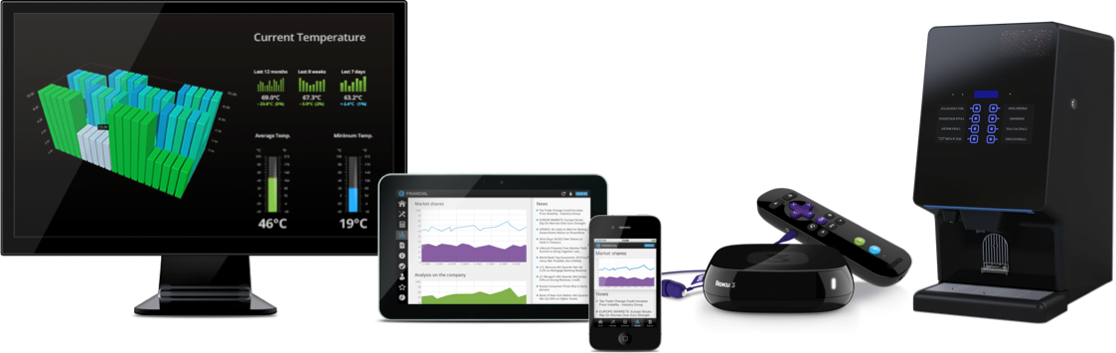
Qt Products
http://www.qt.io
Application
Development
on Desktop,
Mobile and Embedded
Creating
Powerful Devices
Device GUIs,
Ecosystems and whole SDKs

Slide 11



Qt is Used Everywhere
8
8 out of Top 10 Fortune 500 Companies Are Powered by Qt!

Slide 12
Why Qt?
Cross-platform framework
License options and conditions
Programming APIs
Intuitive, predictable, easy to learn
Still a large variety of modules for advanced developers
Reputation for good documentation
Complete
Plenty of examples and tutorials
QtCreator IDE
Free
Debugging, profiling, code analysis
Community
Support
Co-operation
Source code
Complete source code available
Patterns
Similar programming paradigms used everywhere
Observer, model/view, P-IMPL, implicit sharing, delegate
Performance
Highly optimized, although adds some extra functionality

Slide 13
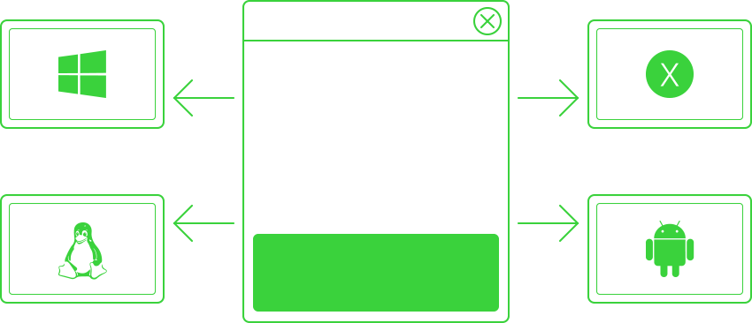
Qt Applications Are Native Applications
Qt / Windows
Windows GDI
Windows Kernel
PC HW
Qt / OSX
Cocoa
Mac Kernel
MacHW
Qt / Embedded
X11, Wayland, EGLFS
Linux Kernel
Embedded HW
Qt / Android
Android NDK
Android Kernel
Android HW

Slide 14
Qt Modules
Essentials
Add-ons
Widgets
C++
Native LAF
Layouts
Styles
OpenGL
Qt Quick
QML
Controls (2)
Layouts
Styles
OpenGL
WebEngine
+ WebView
HTML 5
Hybrid UIs
Charts
3D
Qt Quick Extras
SVG
Data Visualization
Graphical Effects
GUI
Canvas 3D
Virtual Keyboard
Serial Bus
SCXML
Gamepad
Core
Processes
Threads
IPC
Containers
I/O
Strings
Etc.
Multimedia
Audio
Video
Radio
Camera
Network
HTTP
FTP
TCP/UDP
SSL
Serial Port
Bluetooth
Help
Positioning
Location
Concurrent
Printing
Quick Compiler
D-Bus
non-GUI
NFC
Platform Extras
WebSockets
Sql
SQL and Oracle databases
Qt Test
C++
QML
XML
Sensors
WebChannel
Image formats
In-App Purchasing
WebEngine

Slide 15
Licensing Options
http://www.qt.io/licensing/
Support
Commercial
Add-on modules available under commercial
license prior Qt 5.7
GPL v3
Tools and Applications
Qt Tools and Applications are available under GPL v3 and commercial license
Add-on Modules
LGPL v3
Qt Essentials and Add-ons are available under LGPL v3, GPL v2, and commercial license
Qt WebEngine has LGPL v2.1 requirement
Essentials modules

Slide 16
Licensing Options
Commercial license
No limitations of open source licenses
Qt support included
GPL v3
The original license, used in Qt
All proprietary code, IPR etc., will also have to be GPL licensed
No commercial possibilities without opening own source code
LGPL v3
Unlike LGPL v2, forbids creation of closed devices
Adds additional requirements making it less attractive in commercial usage
Mainly DRM restrictions, patent retaliation limitations, and Tivoization
LGPL v2.1
Used prior Qt 5.7
Allows dynamic linking to Qt libraries with any LGPL v2.1 compatible license
Still possible to use with Qt 5.6 LTS (Long Term Support) version

Slide 17
Qt Application Architecture
Application process
QtGUI
GUI events
QGuiApplication : QCoreApplication
QWindow : QObject
GUI events
Signals to slots (observers)
QtCore
QCoreApplication : QObject
QProcess
QThread
QFile
Native calls
Qt Platform
Abstraction plugin
PlatformEventDispatcher
Native GUI events
Platform
Platform APIs
Window server
System server 1
System server 2

Slide 18
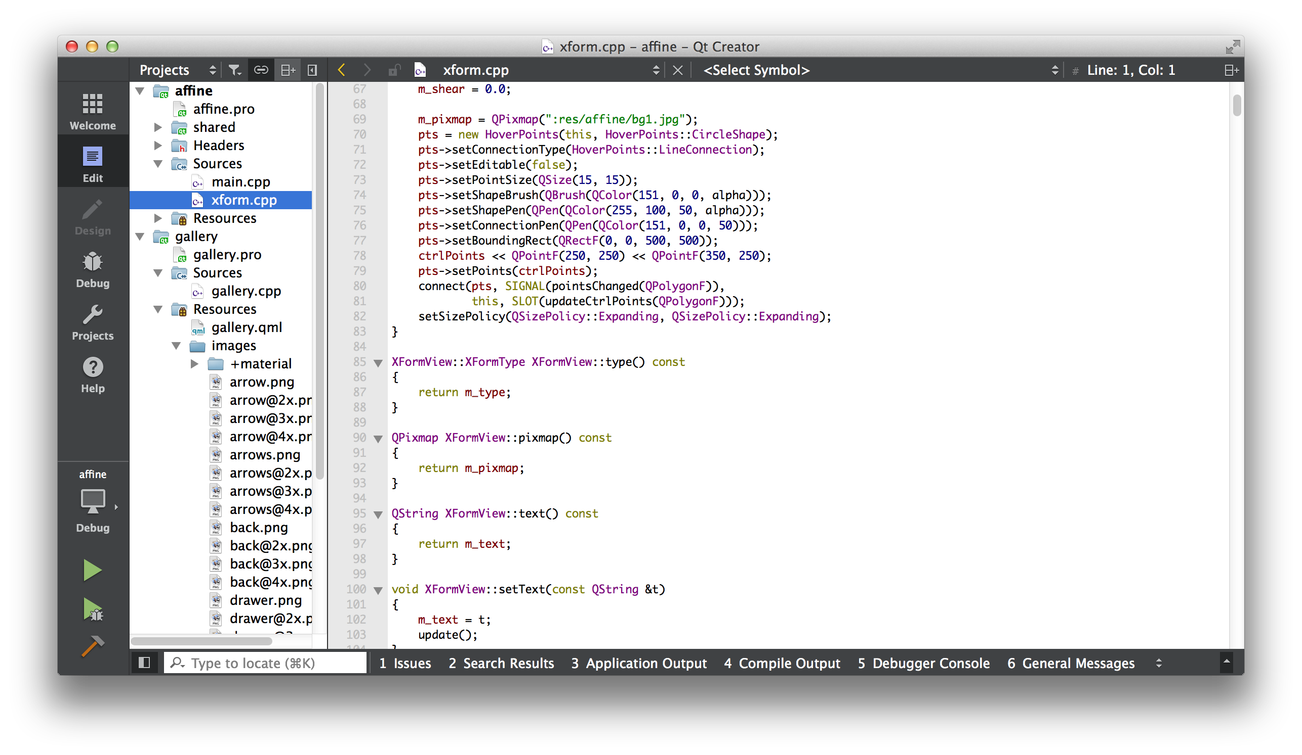
Basic Development Tools
Qt Creator
The de facto IDE for Qt development on all platforms
Contains Qt Designer & Qt Assistant
Qt Assistant
Documentation on various topics, API reference
Qt Designer
Drag’n’drop UI designer application
Separate versions for QWidget and QML –based UIs
Qt Linguist
Localization tool in Qt
Others (qttools/src)
Deployment, font creation (QPF), key mapping, configuration management, test lib, SCXML compiler

Slide 19
Qt Creator IDE
Sidebar
Opened files
Symbol overview
Mode selector
Run
Debug
Build all
Output pane
Quick Open

Slide 20
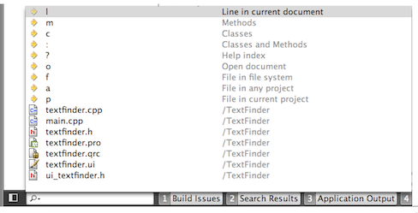
Finding Code – Locator
Click on Locator or press Ctrl+K (Mac OSX : Cmd+K)
Type in the file name
Press Return
Locator Prefixes
:<class name> - Go to a symbol definition
l<line number> - Go to a line in the current document
?<help topic> - Go to a help topic
o<open document> - Go to an opened document

Slide 21
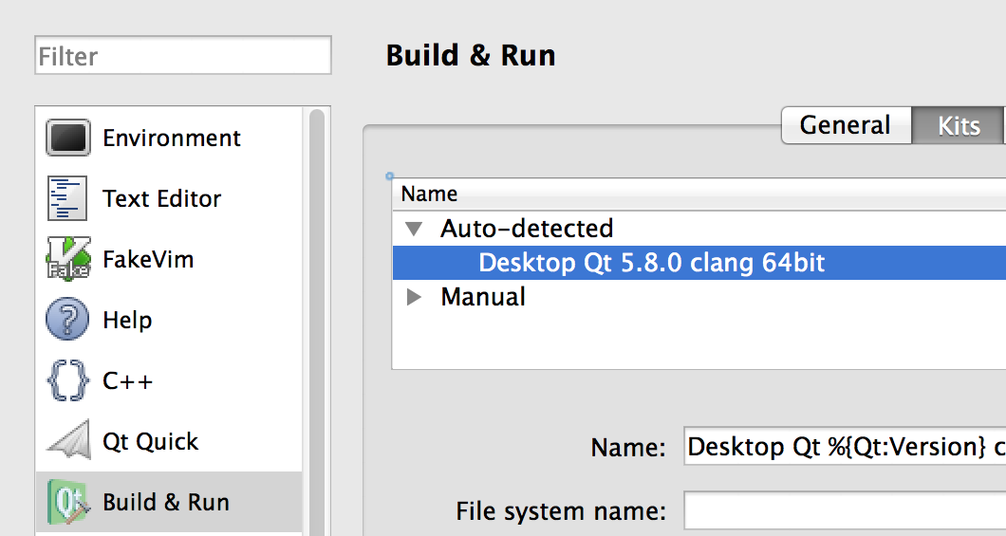
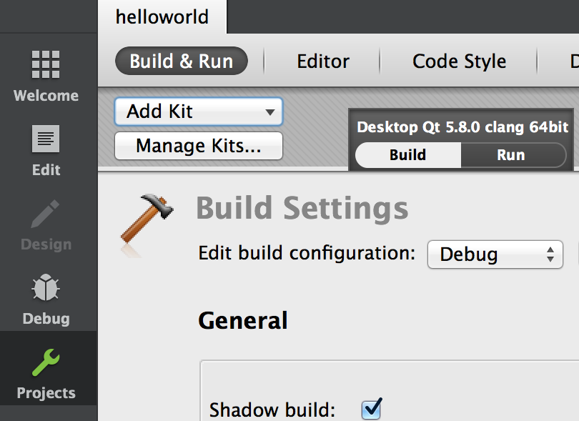
Using QtCreator
Build and run targets defined as kits
Tools > Options – Build & Run: Kits
A kit defines, which
Qt version is used (Qt versions sheet – qmake location)
compiler is used (Compilers sheet)
debugger is used (Debuggers sheet)
In Projects mode kits may be dynamically added/removed
Kit and build type selectable above run/debug buttons
Deployment and on-device debugging easy to configure
Tools > Options – Devices

Slide 22
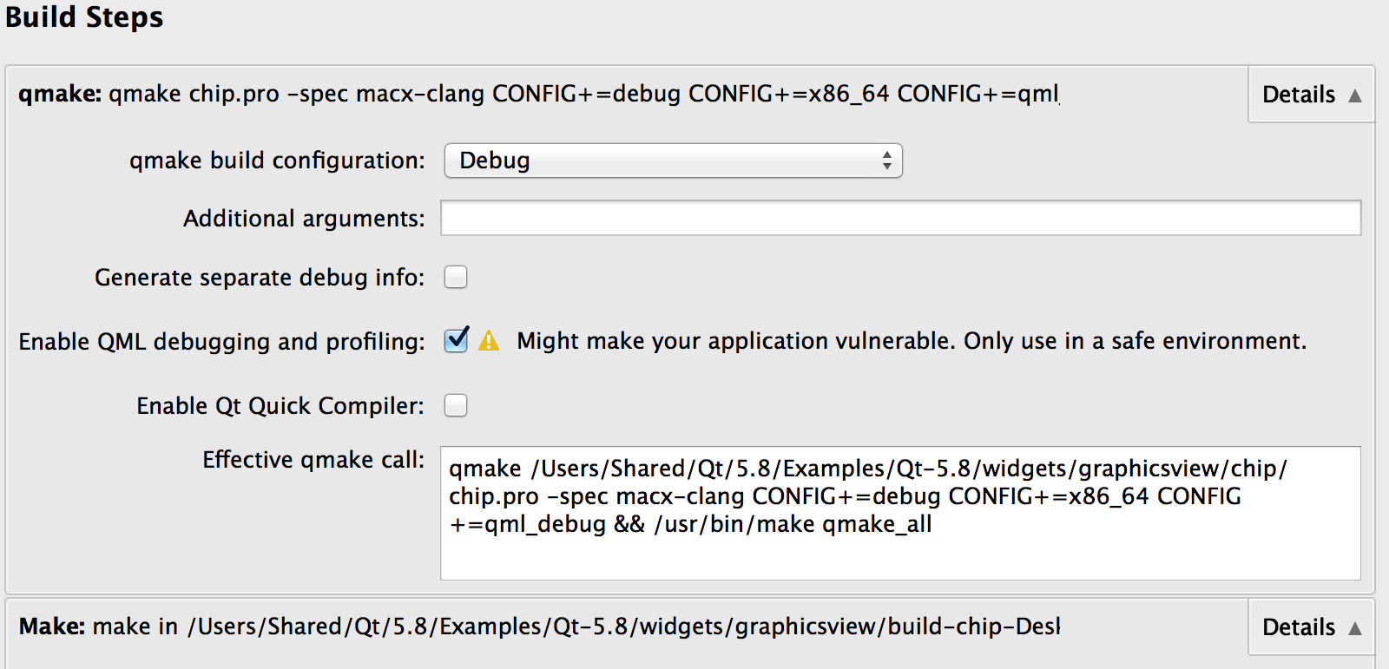
Build and Run Settings – Qt Creator Project Mode
Customize build steps
Add build steps
Add command line arguments
Add/edit environment variables

Slide 23
Qt Build Tools – qmake
Cross-platform makefile and workspace generator
qmake.conf (Qt/<version>/<compiler>/mkspecs/<platform-compiler> )
Uses project-specific .pro file(s)
Additionally, project include files (.pri) and project feature files (.prf) may be used
.pro.user files contain user-specific project configurations and is typically not stored into the repo
Hides platform-specific makefiles from developer
Automatically includes build rules for MOC, UIC and RCC
Can be used for any software project, whether it is written in Qt or not

Slide 24
Qt Build Tools – uic, moc, rcc
UI compiler – uic
Converts XML files, specifying UI forms, to C++
Forms and created with Qt Designer
Meta-object compiler – moc
Generates meta-object data using a QObject class definition
Resource compiler – rcc
Adds built-in and external resources to Qt programs
Resources are defined in an XML-based Qt Resource Collection file (.qrc)
By default, rcc converts resource data to const char arrays, compiled with the program => easy to deploy
External files may be used as well
Resource files can be created and managed in QtCreator

Slide 25
Cross-Compilation Configuration – qmake
If needed, create a target-specific make specification in the folder <Qt src>/qtbase/mkspecs
Use a specification close to your platform (e.g., mkspecs/linux-arm-gnueabi-g++)
Sometimes provider by the chip vendor
It is essential to define cross-compiler tools and build flags (qmake.conf)
QMAKE_CFLAGS = -march=armv7-a -mfpu=neon -mfloat-abi=softfp QMAKE_CXXFLAGS = -march=armv7-a -mfpu=neon -mfloat-abi=softfp QMAKE_CC = arm-fsl-linux-gnueabi-gcc QMAKE_CXX = arm-fsl-linux-gnueabi-g++ QMAKE_LINK = arm-fsl-linux-gnueabi-g++ QMAKE_LINK_SHLIB = arm-fsl-linux-gnueabi-g++ # modifications to linux.conf QMAKE_AR = arm-fsl-linux-gnueabi-ar cqs QMAKE_OBJCOPY = arm-fsl-linux-gnueabi-objcopy QMAKE_STRIP = arm-fsl-linux-gnueabi-strip load(qt_config)

Slide 26
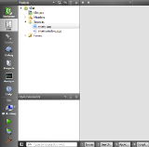
Building Qt Applications
Qt Project
qmake
[Linux/X11]
Makefile
App
in
Linux
GCC
[Linux compiler]
Qt/C++
code files
.pro
file
Qt/C++
code files
Qt/C++
code files
qmake
[Embedded Linux]
Makefile
Cross compiler
App
in
Target HW
qmake
[INTEGRITY]
.gpj
App
in
Target HW
Other IDE / Code Editor
MULTI
Native tool chains
Qt Creator

Slide 27
Useful qmake Variables
TEMPLATE - Defines the type of project
app, vcapp
lib, vclib
subdirs
TARGET
Name of the executable (by default equals to the .pro file name)
QT
Qt-specific modules and their dependencies defined in mkspecs/modules
QT += webkit sql network charts
CONFIG
Specifies a project configuration or compiler option – used internally by qmake
May refer to a project feature a .prf file in mkspecs/features
Custom features can be added using CONFIG += myFeatures
INCLUDEPATH and DEPENDPATH
Sets the include search path (-I option)
RESOURCES
Specifies resource collection (.qrc) files to include in build
LIBS
DEFINES
INSTALLS
Files and folders to be copied after building (make install)
Hint! Additional variables and values may be defined in the command line:
qmake “CONFIG += debug”

Slide 28
Qmake Usage
Scopes
win32:debug { SOURCES += paintwidget_win.cpp }
Single line conditional assignment
win32:DEFINES += QT_DLL
Environment variable reference
DESTDIR = $$PWD # Evaluated when the .pro file is processed (qmake executed)
DESTDIR = $PWD # Evaluated when the Makefile is executed
Variable reference
TARGET = myproject_$${TEMPLATE}
Configuration options
You may ask the options with the command qmake –query
message(Qt version: $$[QT_VERSION])
Hint! You may define project dependencies in the declarative way using Qt Build Suite (QBS).
https://wiki.qt.io/Qt_Build_Suite

Slide 29
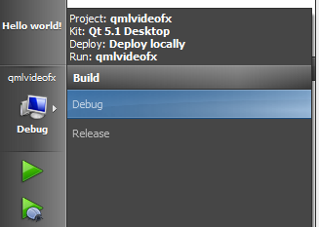
Debugging
Any debugger can be used with Qt
The default debugger is GDB (CDB)
All GDB features can be used in the command line, a subset in QtCreator
The basic features are
Breakpoints
Step-by-step debugging
Variable value read/write
Watch points
Select a debug build and
Start debugging

Slide 30
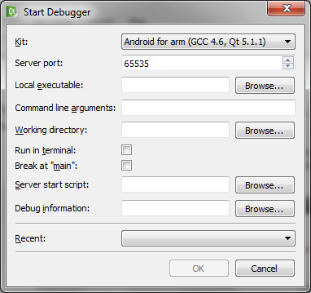
Remote Debugging
Start GDB or CDB server
Network connection required
gdbserver :4711 <myProgram>
cdb.exe -server tcp:port=4711 <myApp>

Slide 31

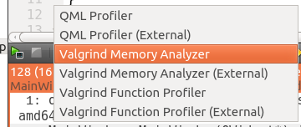
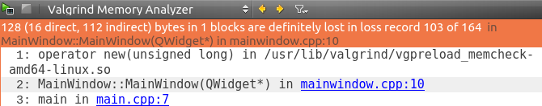
Analyzing Memory
Requires valgrind tool
sudo apt-get install valgrind
Click Analyze button on the left button panel in QtCreator
Start the analyzer
Study the results
Object allocated in mainwindow.cpp line 10 leaks

Slide 32
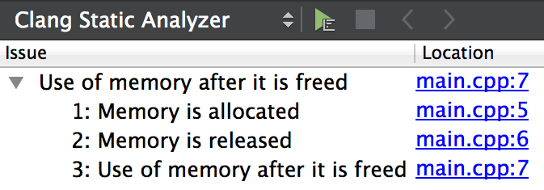
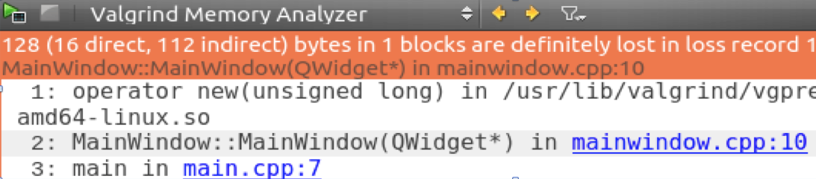
Code Analysis
C++ code analysis require a backend
QML analysis can be done with Qt tools
Clang static analyzer
Uses clang open source library as a backend
Detects more than a compiler (e.g. use of dangling pointers)
Valgrind memory analyzer and profiler
Detects, e.g., memory leaks and most frequently executed functions

Slide 33
Qt Coding Convention
// Avoid acronyms, use camel-case
// Class names with capital first letter
// Function and variable names lower case first letter
#include <QObject>
class CustomObject : public QObject
{
Q_OBJECT
public:
explicit CustomObject(QObject *parent = 0);
void setString(const QString &string);
QString string() const;
protected:
bool event(QEvent *event) Q_DECL_OVERRIDE;
private:
QString m_string;
};
#include <QApplication>
#include <QLabel>
#include "customobject.h”
int main(int argc, char *argv[])
{
QApplication application(argc, argv);
QLabel label;
CustomObject customObject;
customObject.setString("Hello world");
label.setText(customObject.string());
label.show();
return application.exec();
}
#include "customobject.h"
CustomObject::CustomObject(QObject *parent) : QObject(parent) { }
void CustomObject::setString(const QString &string)
{
if (string != m_string) m_string = string;
} bool CustomObject::event(QEvent *event)
{
// Dummy example
return QObject::event(event);
}

Slide 34
Qt Debugging Aids – Logging
QDebug allows streaming debug information to QString or any QIODevice
QIODevice subclasses: QBuffer, QFileDevice, QProcess
Often more convenient to use macros qInfo(), qDebug(), qWarning(), qCritical(), and qFatal()
Macros expand to corresponding function calls in QMessageLogger
Message logger uses QtMessageHandler
Suppress messages by adding DEFINES += QT_NO_DEBUG_OUTPUT QT_NO_WARNING_OUTPUT QT_NO_INFO_OUTPUT to your .pro file or installing a custom message handler
QDebug debug(myDebugDevice); // May be Qstring too
debug << "Something happened";
// #include <QtDebug>
qDebug("Method computed: %d", intVariable);
qDebug() << "Mouse was clicked at " << mouseEvent->pos();
QMessageLogger(__FILE__, __LINE__, Q_FUNC_INFO).debug() << "Oh no”;

Slide 35
Logging Message Categories
Allows controlling which messages to log and which to ignore
Message types (debug, warning etc.) and categories can be enabled/disabled
Define a category using QLoggingCategory or use macros to declare and define categories
Q_DECLARE_LOGGING_CATEGORY(aCategory)
Q_LOGGING_CATEGORY(aCategory, "com.theqtcompany.application", QtWarningMsg)
QLoggingCategory category("com.theqtcompany.app"); category.setEnabled(QtDebugMsg, false); qCWarning(category) << "A warning message";
qCDebug(category) << "This is not logged";
qCWarning(aCategory) << "Another warning message";
// Outputs:
// com.theqtcompany.app: A warning message
// com.theqtcompany.application: Another warning message

Slide 36
Category Rules and Filters
Categories may be configured globally by setting logging rules or installing a custom filter
<category>[.<type>] = true | false
Rules may be defined in four ways (rules evaluated in the following order)
In a configuration file (QtProject/qtlogging.ini) using [Rules] section
By defining rules by setFilterRules()
By defining a custom configuration file using the QT_LOGGING_CONF environment variable
By defining rules in the QT_LOGGING_RULES environment variable
Or install a custom filter
void myCategoryFilter(QLoggingCategory *);
QLoggingCategory::setFilterRules("*.debug=false\n"
"com.theqtcompany.something.debug=true");

Slide 37
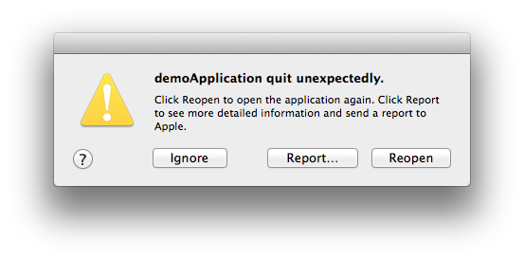
Qt Debugging Aids – Asserts
Q_ASSERT and Q_ASSERT_X
Uses qFatal(), which aborts the application, when the default message logger used
Q_ASSERT_X(1 > 2, Q_FUNC_INFO, "False condition");
// Q_ASSERT(false);
// Outputs:
ASSERT failure in int main(int, char **): "False condition",
file ../demoApplication/main.cpp, line 17
The program has unexpectedly finished.

Slide 38
Qt Debugging Aids – Debug Dumps
Each QObject can be named with QObject::setObjectName()
The name can be retrieved with QObject::objectName()
As a lot of the debugging information is only really helpful if these names are set, it is good Qt programming style to do so
Debug dumps
Work only in debug builds
QObject::dumpObjectInfo() dumps information about object internals, like signals/slots
QObject::dumpObjectTree() dumps the parent/child relationships of all descendant objects
OBJECT QApplication::unnamed
SIGNALS OUT
signal: destroyed(QObject*)
signal: destroyed()
signal: objectNameChanged(QString)
QApplication::
QCocoaEventDispatcher::
QSessionManager::
QMacStyle::macintosh

Slide 39
Help and Further Reading
I need answers ASAP
Use Qt support http://www.qt.io/support/
Meet Qt professional in IRC https://wiki.qt.io/Online_Communities
Questions and answers forum – Qt Centre http://www.qtcentre.org/content/
It does not work
Bug reporting and finding https://bugreports.qt.io/
Stack Overflow http://stackoverflow.com
I have some time to study Qt myself
Qt Developer Guides http://wiki.qt.io/Developer-Guides
Learning videos https://www.youtube.com/user/QtStudios
Books, tools, guides, documentation - http://wiki.qt.io/Main_Page
I want to know the latest Qt updates
Qt Blog http://blog.qt.io
I want to have some Qt apps for free
http://qt-apps.org

Slide 40
Objects in Qt

Slide 41
Contents
QObjects vs. Value Types
Memory Management
Qt Smart Pointers
Meta-Object System
Signals and Slots
Properties

Slide 42
QObjects and Value Types
Compare, for example QObject and QString class headers
Qt’s 1,500 classes can be divided into two groups
Identity types
Value types
Identity types
derive from QObject
extend C++ with many dynamic features using a meta-object system
cannot be copied as the copy constructor and assignment operator equal to delete
QWidget, QWindow, QApplication, QEventLoop, QThread, QFile, QTcpSocket
Value types are standard C++ classes
QColor, QEvent, QDataStream, QMetaType
~100 value types use copy-on-write pattern – implicitly shared
QString, QByteArray, QList, QVector, QHash, QCache, QDir, QPixmap, QImage, QBrush, QPen

Slide 43
Memory Management: Creating QObjects
Each QObject may be a parent or child of another QObject
Objects create a tree structure
Child objects must be allocated on the heap using new
Parent object owns the children and eventually calls delete
QLabel *label = new QLabel(”Some Text”, parent);
Objects not inheriting QObject are allocated on the stack, not the heap
QStringList list; // Implicitly shared class
QColor color; // Just a basic class
Exceptions
QFile and QApplication (inheriting QObject) are usually allocated on the stack
Modal dialogs are often allocated on the stack, too
Obviously, not this straightforward always
If the object life-time is not known (shared between multiple threads, for example)

Slide 44
Object Deletion – deleteLater()
An object must not be deleted, while it is handling an event
QObject::deleteLater() slot schedules the object for deletion
The object deleted, when the control returns to the event loop
If the thread does not have an event loop, the object deleted when the thread finishes
connect(threadPtr, &QThread::finished, threadPtr, &QThread::deleteLater);
At least one event loop must be running or started later
Otherwise the object is not deleted
Calling deleteLater() more than one for the same object does not cause double deletion

Slide 45
Object Deletion – QScopedPointer
Demo: smartPointers
Deletes the referenced object, when the pointer goes out of the scope
Unlike QPointer, can be used for any type
Four different cleanup handlers
QScopedPointerDeleter
QScopedPointerArrayDeleter
QScopedPointerArrayDeleter
QScopedPointerDeleteLater
QScopedPointer<int, QScopedPointerArrayDeleter<int>> intArrayPointer(new int(100));
Useful in functions with several exit paths
E.g. exceptions
Simplifies the code
Often used to delete dynamically allocated member variables as well

Slide 46
Object Deletion – QPointer
Demo: smartPointers
Object tree does not solve the dangling pointer problem
QPointer provides a guarded pointer for QObject
Sets pointer to 0, when the referenced object destroyed
Easy to mix guarded and normal pointers
Guarded pointer automatically cast to the pointer type
Qt objects may also notify observers just before their destruction
// ExampleObject is just QObject subclass
QPointer<ExampleQObject> object(new ExampleQObject);
delete object;
if (object)
qDebug() << ”Dangling pointer";
else
qDebug() << "No dangling pointer";

Slide 47
Data Sharing
Demo: sharedData
Data sharing
Shared data pointer does not get destroyed, if there are any references to it
No need to worry who deletes the data and when
Strong and weak data pointers
Implicit sharing
Similar to data sharing, but data gets automatically copied, if any referencing object changes the data
Explicit sharing
Similar to implicit sharing, but data is never copied implicitly
QSharedPointer<MyObj> sharedPointer =
QSharedPointer<MyObj>(new MyObj, &QObject::deleteLater);
QWeakPointer<MyObj> weakPointer(sharedPointer);
if (weakPointer)
// Referenced object still exists

Slide 48
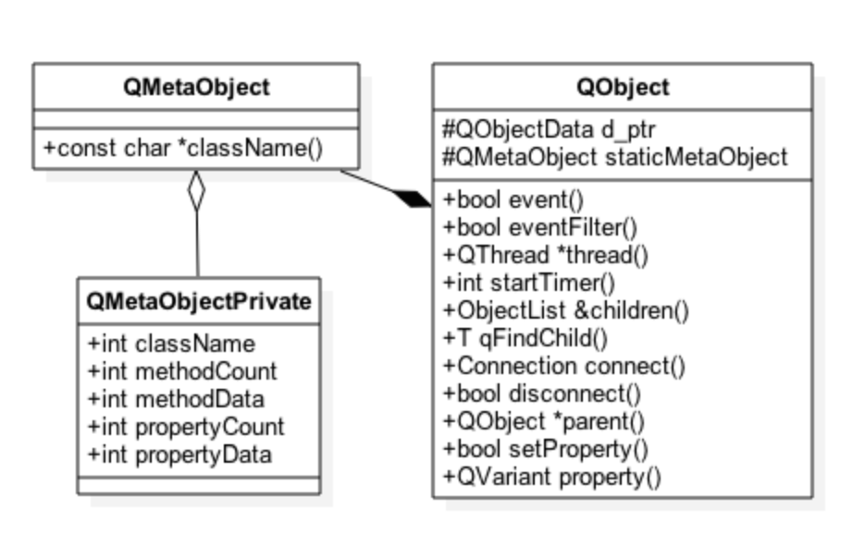
Meta-Object System
Adds dynamic features to Qt objects
Features can be introspected via QMetaObject
Class and parent class names
Class info
Method information
Type: constructor, signal, slot, method
Signature
Properties
Enumerations and flags
Q_OBJECT macro defines a static meta-object
Actual object data generated with the moc tool

Slide 49
Qt Object Class Declaration – QWindow
Q_OBJECT macro
One enum added to the meta-object
Signals and slots
Properties
class Q_QUICK_EXPORT QQuickWindow : public QWindow
{
Q_OBJECT // Defines a static meta-object for the class
Q_PROPERTY(QColor color READ color WRITE setColor NOTIFY colorChanged)
Q_PROPERTY(QQuickItem* contentItem READ contentItem CONSTANT)
public:
enum SceneGraphError { ContextNotAvailable = 1 };
Q_ENUM(SceneGraphError)
Q_SIGNALS:
void frameSwapped();
void openglContextCreated(QOpenGLContext *context);
void sceneGraphInitialized();
public Q_SLOTS:
void update();

Slide 50
Object Communication: Signals and Slots
A signal is a way to notify an observer that something has happened
A mouse pressed on a UI control, for example
Signals are member functions that are automatically implemented in the meta-object
Signal is sent, or emitted, using the keyword emit or Q_EMIT - actually does not do anything
Q_EMIT someSignal(7, “Hello”);
A slot is a function that is to be executed after a signal has been emitted
On a mouse press, start an animation
A slot function may be a member function, a non-member function or a lambda function
Signals are connected to other signals or slots
Many-to-many relationship
Signal and slot parameter types must match, but the slot may omit any number of trailing parameters

Slide 51
Qt Object Class Declaration with Signals and Slots
class CustomObject : public QObject
{
// Q_OBJECT macro defines among other things a static meta object
// Required for signals and string-based slots
Q_OBJECT
public:
explicit CustomObject(QObject *parent = 0) : QObject(parent), m_value(42) { }
Q_SIGNALS: // Macro expands to public
simpleSignal(int, const QString &); // Or alternatively Q_SIGNAL prefix
// Slots are often setters
public Q_SLOTS: // Or alternatively Q_SLOT prefix
void setValue(int value) { if (value != m_value) m_value = value; } private:
int m_value;
};

Slide 52
Connections
To receive a signal in a slot (or in another signal), a signal and a slot (or a signal) must be connected
QMetaObject::Connection connection = QObject::connect(
senderObject, const QMetaMethod &signal, observerObject,
const QMetaMethod &method, Qt::ConnectionType type);
Use the connection object to check, whether the connection succeeded or to disconnect (especially, if lambda expressions used)
When an object is destroyed, all its connections are removed
Signal and slot signatures must match
Slot may ignore any number of parameters from the end of signal parameter list

Slide 53
String and Functor-Based Connections
Uses strings
SIGNAL(someSignal(int, QString))
No compile-time error checking
Can connect to slots with more (default) parameters than the signal
Can connect C++ functions to QML functions
QObject::connect(
senderObject,
SIGNAL(notify(int, QString)),
receiverObj,
SLOT(slotFunc(int, Qstring)));
Uses function pointers
Do not use other functions, but signals, slots or lambdas
Compile time error checking
Can perform implicit type conversions
Overloaded signals or slots increase complexity
QObject::connect(
senderObject,
&Sender::notify,
receiverObj,
&Receiver::slotFunc);

Slide 54
Connection Variants
No special syntax for slots
Compile time error (parameter match) checking
Q_OBJECT not needed for slots
Using function pointers
connect(slider, &QSlider::valueChanged, spinbox, &QSpinBox::setValue);
Overloaded slots used as function pointers (need to explicitly define signal parameters)
void (SomeClass:: *signal)(int, QString) = &SomeClass::overloadedSignal;
connect(spin, qOverload<int>
(&QSpinBox::valueChanged), slider, &QSlider::setValue);
connect(spin, static_cast<void (QSpinBox::*)(int)>
(&QSpinBox::valueChanged), slider, &QSlider::setValue);

Slide 55
Connection Variants
Demo: connectLambda
Using non-member function
static void printValue(int value) {...}
connect(slider, &QSignal::valueChanged, &printValue);
Using C++11 lambda functions
connect(slider, &QSlider::valueChanged, [=] (int value) {...});

Slide 56
Connection Types
Demo: delayedInit
Qt::AutoConnection – the default connection type
Actual connection type determined, when a signal is emitted
Connection type depends on signaling and receiving objects’ thread affinity
Qt::DirectConnection - An immediate slot function call
Qt::QueuedConnection – A delayed function call
Signaling object sends an event to the receiving object
Qt::BlockingQueuedConnection – Signaling thread blocks, until the slot is executed
Qt::UniqueConnection – Prevents multiple instances of the same connection

Slide 57
Disconnecting Signals
Disconnect everything connected to an object’s signals
disconnect(senderObject, 0, 0, 0); // sender (cannot be 0), signal, receiver, slot
Disconnect everything connected to a specific signal
disconnect(senderObject, &Object::theSignal, 0, 0);
Disconnect a specific receiver
disconnect(senderObject, 0, receiver, 0);
Disconnect a specific connection
disconnect(senderObject, &Object::theSignal, receiver, &Object::theSlot);
If connected to lambda expressions, use the following overloaded version of the disconnect() function:
bool QObject::disconnect(const QMetaObject::Connection &connection);

Slide 58
Qt Property System
Data members of QObject-derived classes can be exposed as properties
Used by some Qt frameworks (property animations, QML, style sheets)
Properties are defined in class declarations using the Q_PROPERTY macro:
Q_PROPERTY(QString title READ title WRITE setTitle)
Q_PROPERTY(bool enabled MEMBER m_enabled)// Additionally either READ or WRITE
// can be provided but not both
Properties can be accessed using base class functions
QObject::property() and QObject::setProperty()
No need to know the exact type of the target object!
If the property named in QObject::setProperty() does not exist, it will be dynamically added to the object at run-time (dynamic property)
Properties may have other attributes: NOTIFY, SCRIPTABLE, DESIGNABLE, MEMBER, FINAL

Slide 59
Providing Properties from QObject
Q_PROPERTY(Type name
(READ getFunction [ WRITE setFunction ] |
MEMBER memberVariable [( READ getFunction | WRITE setFunction )])
// MEMBER is straightforward mapping to a member variable
// If any processing is required, use READ / WRITE
[ RESET resetFunction ] // Implemented, if reset is different from WRITE
[ NOTIFY notifySignal ] // Emitted, when the property value changes
[ REVISION int ] // Used often in QML to define API revision
[ DESIGNABLE bool ] // Property accessible in Qt Designer
[ SCRIPTABLE bool ] // Property accessible in Qt Script
[ STORED bool ] // False, if property not stored by object
[ USER bool ] // One essential property can be marked USER
[ CONSTANT ] // Constant property, no WRITE or NOTIFY
[ FINAL ] // Property not overridden in subclasses

Slide 60
Qt Property System
Demo: properties
class ExampleQtObject : public QObject
{
Q_OBJECT
Q_PROPERTY(Employee employee MEMBER m_employee NOTIFY employeeChanged)
Q_PROPERTY(AQtObject *objectProperty MEMBER m_object NOTIFY objectPropertyChanged)
public:
explicit ExampleQtObject(QObject *parent = 0);
Q_SIGNALS:
void employeeChanged(); void objectPropertyChanged ();
private:
Employee m_employee;
AQtObject *m_object;
};

Slide 61
Enumerations
Enumerations and flags can be made accessible via the meta object
Can be used as property types as well
Q_ENUM – registers the enum type with both the meta-object and meta-type system
Q_FLAG – Registers flags (defined as Q_DECLARE_FLAGS) using Q_ENUM
class ExampleQtObject : public QObject
{
Q_OBJECT
Q_PROPERTY(Regions regions MEMBER m_regions NOTIFY regionsChanged)
public:
explicit ExampleQtObject(QObject *parent = 0); enum Region { Africa = 0x01, Americas = 0x02, Asia = 0x04, Australia = 0x08 };
Q_DECLARE_FLAGS(Regions, Region)
Q_FLAG(Region) // Q_FLAG registers the enumeration using Q_ENUM Q_SIGNALS:
void regionsChanged(); private:
Regions m_regions;

Slide 62
Summary
Qt has three kinds of classes
Object classes derived from QObject
Value-based classes without a special base class, but all of them use implicit sharing
Other classes
QObject provides
Memory management based on simple parent-child relationship
Meta-object system
Event handling
Meta-object system is extension to C++
Allows object introspection without RTTI
Flexible observer pattern based on signals and slots
Property system used by QML, for example

Slide 63
Meta-Type System

Slide 64
Contents
Variants
Custom Types and Variants

Slide 65
Variants
QObject property types can be any type, supported by QVariant
QVariant acts like a union for common Qt value types (copyable, assignable)
Holds a single value of type T (ask with type()) at a time
It’s easy to create QVariant objects as the inverse conversion is automatic for all supported data types
QVariant variant = QColor(Qt::red);
Conversion functions exist for QtCore types – for other types use template functions
QString string = variant.toString(); // Qstring is a core type
QFont textFont = settings.value("TextFont").value<QFont>());
It is possible to check, whether the conversion can be done and convert explicitly
if (variant.canConvert<SomeType>())
SomeType variable = variant.value<SomeType>();

Slide 66
QVariant Examples
QVariant v(123);
// The variant now contains an int
int x = v.toInt(); // x = 123
v = QVariant("hello");
// The variant now contains a QString
v = QVariant(tr("hello"));
// The variant now contains a QString
int y = v.toInt();
// y = 0 since v does not contain a number, like “567”

Slide 67
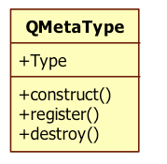
Supported Types
Types known by QMetaType van be accessed using QVariant
QMetaType manages named types
Allows creating, destroying, copying, and serializing values
Required for queued method invocations and property system (signal parameter values marshalled to event arguments as QVariant)
Designed for assignable types
Extendable via Q_DECLARE_METATYPE(MyType) / qMetaTypeId<MyType>()
Integrated with QVariant
Makes value types dynamic
Completes introspection functionality to non-QObject types by associating a type name to a type
Contains an enumeration of core types (JSON types added in Qt5)
create() / construct()- create an object or construct an object in a memory location
destruct() / destroy() – call destructor or delete
load() / save() – load and save from/to QDataStream (serialization operators needed)

Slide 68
Custom Types and QVariant
To add custom types, use Q_DECLARE_METATYPE(Type);
Adds custom type to QMetaType system
Makes type available for QVariant and other template-based functions
Type must support default construction, copy, and assignment
Should appear after class definition in header file
// contact.h:
class Contact {
public:
void setName(const QString name);
QString name() const;
...
}; // make Contact known to meta-type system
Q_DECLARE_METATYPE(Contact);

Slide 69
Custom Types and QVariant
#include <QtGui>
#include "contact.h" // must have Q_DECLARE_METATYPE there
int main(int argc, argv)
{
QApplication app(argc, argv);
// ...
Contact c;
c.setName("Peter");
QVariant v = QVariant::fromValue(c);
Contact c2 = v.value<Contact>();
qDebug() << c2.name(); // "Peter"
qDebug() << v.typeName(); // prints "Contact"

Slide 70
Limitations on Custom Types
Demo: customSignals
If you use queued connections, the parameters must be of types that are known to Qt's meta type system
Parameters copied into an event, which is passed between a signalling and receiving object
Any type or structure with a public default constructor, public copy constructor, and public destructor can be used
Register your type to the meta-object system using Q_DECLARE_METATYPE()
Adds a named type (“MyType”) to meta type enumeration (42)
Additionally, you need to call qMetaTypeId<MyType>() or qRegisterMetaType() before making the first queued connection (to enable run-time name resolution)
The latter is used for typedefs only
Custom types used in the Qt property system must be registered as well

Slide 71
Summary
Lab 1: Signals and Slots
QObject properties are QVariant types
QVariant holds a single type and value at a time
Type may be anything, known by the meta-type system
Custom types may be added to the meta-type system with Q_DECLARE_METATYPE macro, which is used after the class definition
In some cases, custom types are dynamically created
If types are used in queued connection arguments
If types are used in properties
In these cases, custom type requires registration as well with qRegisterMetaType() or qMetaTypeId()

Slide 72
Event Handling

Slide 73
Contents
Events
Basic Event Handling
Event Loop
Event Dispatching
Custom Events
Event Filters

Slide 74
Event Processing
Application process
Events/signals to other objects
GUI events
Qt GUI
QWindow
QWidget / QQuickItem
Qt Core
QCoreApplication – runs the event loop
paints
Qt Platform Abstraction plugin
Platform-specific event dispatcher
Backing store / OpenGL context
events
Platform APIs
Platform-specific window system / frame buffer

Slide 75
Event Handling in Brief
In Qt, events are objects that are delivered to event handling functions
Base class QEvent, subclasses like QMouseEvent, QKeyEvent, QTimerEvent, QTouchEvent
When an event occurs, Qt creates the event object and delivers the event to the particular QObject
=> bool QObject::event(QEvent& e)
Does not handle the event, redelivers to a corresponding virtual event handler
Own virtual protected functions for different events
Returns true if the event was handled, false otherwise
Certain subclasses (such as QWidget) re-implement this function!

Slide 76
QEvent
Base class for all events in Qt
Contains an event type parameter and ”accepted” flag
QObject::event() checks the flag value and returns true or false accordingly
The flag can be set and unset using QEvent::accept() and QEvent::ignore(), respectively
By default the flag is set but some subclasses might clear it in their constructor
Always check the actual event subclass documentation
In case a child ignores the event, it will be propagated to a parent
Subclasses may contain more parameters describing the event
QKeyEvent contains the key code, QMouseEvent contains the mouse press coordinates etc.

Slide 77
Handling Events – the Easy Way – 1(2)
QObject
If you want your QObject (or QWidget) subclass to…
Respond to key presses, implement:
void keyPressEvent(QKeyEvent&)
Use timer via QObject, implement:
void timerEvent(QTimerEvent&)
Respond to mouse presses, implement:
void mousePressEvent(QMouseEvent&)
React to layout changes, implement:
void resizeEvent(QResizeEvent&)
void moveEvent(QMoveEvent&)
And so on… – quite straightforward from the developer’s point of view!
event
(QEvent&)
MySubClass
keyPressEvent
(QKeyEvent&)

Slide 78
Handling Events – the Easy Way – 2(2)
Each virtual handler function can either
Replace the base class implementation completely, or
Extend the base class functionality by only replacing a part of the functionality
You must call the base class implementation for cases not handled by the subclass to obtain the default behavior of the function
Remember also to call accept() or ignore() on the event if needed!
void MyCheckBox::mousePressEvent(QMouseEvent *event) {
if (event->button() == Qt::LeftButton) {
// Handle left mouse button here - with mouse
// events “accepted” flag is set by default
} else {
// Pass on other buttons to base class
QCheckBox::mousePressEvent(event);
}
}

Slide 79
Custom Events
Custom events can be created simply by inheriting QEvent
Use an event code between QEvent::User (1000) and QEvent::MaxUser (65535)
Qt does not understand user events
Implement QObject::customEvent() in the receiving object
Optionally, you can re-implement QObject::event() and make your implementation also use other callback functions than just customEvent()

Slide 80
Event Categories
Demo: syntheticEvents
Spontaneous events
Asynchronous, e.g. mouse or key press events
Generated by the underlying window system
Read and queued by a QPA plug-in
Processed by the event loop
Posted events (QCoreApplication::postEvent())
Asynchronous, e.g. signals across threads (Qt::QueuedConnection)
Generated by Qt or the application itself
Queued by Qt and processed by the event loop
More importantly, system can compress several posted events into one!
Sent events (QCoreApplication::sendEvent())
Synchronous, e.g. calling QWidget::repaint()
Generated by Qt or the application itself
Sent directly to the target object
Hint! To process events during a long running task in any thread, call:
QCoreApplication::processEvents();
QAbstractEventDispatcher::processEvents();

Slide 81
Sending and Posting Events
Note that you have to have a pointer to the object you are sending/posting the event to
Certain static QApplication functions can be useful in order to retrieve pointers, for example:
QWidget* QApplication::activeWindow(),
QWidget* QAppliation::focusWidget()
Remember that in some cases similar behaviour as sending and posting events can be achieved more simply with signals and slots!

Slide 82
Event Processing – Event Loops
All event loops in Qt are represented by the class QEventLoop
QEventLoop can be used to launch local event loops
The main event loop is launched using QApplication::exec()
Main event loop tells the event dispatcher what to do, how to do it
For example: wait for an event, exclude user input events
Event loop is modal
QApplication::exec(), QEventLoop::exec(), etc. are blocking
QDialog, QMenu also have exec() functions
Continues processing until told to stop by calling exit()
Event-loop is recursive
Any of the exec() functions can re-curse
Except for QApplication::exec()
Use with caution, unexpected recursion can happen

Slide 83
Event Dispatcher
Base class: QAbstractEventDispatcher
Receives events from the window system and other sources via QEventLoop
Delivers events to QCoreApplication
Platform-specific implementations are made by subclassing QAbstractEventDispatcher
QEventDispatcherWin32, QEventDispatcherLinux
Can be used to tie Qt event handling to external or native event loops

Slide 84
Event Filters
Sometimes you need to add the same functionality to a number of different widgets (reacting on a certain event the same way)
…or you might want block/hijack events aimed at a certain widget (e.g. a QPushButton on the screen)
The usual way to do this is to subclass each widget and implement the required event handler function(s)
This is cumbersome if all you try to obtain is the possibility to e.g. add common mouse movement handling to widgets or block certain events
The solution: use one or more event filters

Slide 85
Event Filters
Demo: eventFilter
Implementing an event filter is very easy:
Subclass from QObject (or any subclass of QObject) and re-implement the method
bool eventFilter(QObject *receiver, QEvent *event)
This method returns true if the filter handles the given event, false otherwise
The event filter can be installed for any object by invoking the method QObject::installEventFilter()
An application-global event filter can be installed by invoking installEventFilter() on the QCoreApplication instance
Avoid in general because of performance loss
Good for debugging – e.g. why my gestures do not work?
// qflickgesture.cpp
case QEvent::TouchEnd:
result |= scrollerIsActive ? FinishGesture : CancelGesture;
break;

Slide 86
Further Notes
Events are not handled at all for objects whose thread affinity is NULL (i.e. do not belong to any thread)
An object and its event filter need to be in the same thread (i.e. have the same thread affinity) - otherwise QObject::installEventFilter() does nothing
Furthermore, if one of them is moved to another thread after installation, the event filter will not be called before both are in the same thread again (the filter is not removed by the system)

Slide 87
Summary
Lab 2: Event Handling
Qt is an event-driven system
There are two kinds of events in Qt
Spontaneous events are created by external window system and handled by Qt
Synthetic events are created by applications themselves
Synthetic events can be
Sent synchronously
Posted asynchronously
Events are QEvent type objects
Custom events can be created and custom event handlers can be implemented
Event filters may be installed globally to an application instance and to any QObject type object

Slide 88
Core Classes

Slide 89
Contents
String Handling
Item Containers
File Handling
Data Streams and Serialization

Slide 90
QString
Demo: codec
Container for 16-bit Unicode 4.0 QChars
Support for 32-bit unicode characters
Uses QTextCodec to interpret characters
QByteArray provides a container for raw data and 8-bit characters
May be used in programs with strict memory requirements
Both classes implicitly shared
QString string1("abc"); // Makes a deep copy of “abc”
QString string2(string1); // Makes a shallow copy of string1
Both strings share the same data, until either string changes the shared data

Slide 91
String Creation
Strings can be created in a number of ways:
Conversion constructor and assignment operators:
QString emptyAndNullString; QString emptyString(“”);
QString str("abc"); // Uses QString::fromUtf8() function
str = "def”;
From a char pointer using the static functions:
QString text = QString::fromLatin1("Hello Qt");
QString text = QString::fromUtf8(inputText);
QString text = QString::fromLocal8Bit(cmdLineInput);
QString text = QStringLiteral("Literal string"); (Assumed to be UTF-8)

Slide 92
String Creation
From a number overloaded static functions
QString n = QString::number(1234); // (u)int, u(long), double
From char pointer with translations:
QString text = QObject::tr("Hello Qt");
From standard strings
QString string(QString::fromStdString(std::string("hello")));
QString string(QString::fromStdU16String(u"Europe:\u20ac Japan:\u00a5"));
QString string(QString::fromStdU32String(U"Europe:\u20ac Japan:\u00a5"));

Slide 93
String Creation and Performance
QString is “expensive” to create from double-quoted ASCII literals
String allocation, deep copy of the data, decoding using the selected codec
Automatic conversion can be disabled with DEFINES += QT_NO_CAST_FROM_ASCII
In this case, QLating1String can be used as a thin wrapper to char pointer string
Avoid creating temporary QString objects
Many member functions (assignment, comparison, insert, replace etc.) work directly with const char * without a conversion to QString
Faster to compare QString as aStr == “hello” or aStr == QLatin1String(“hello”) than aStr == QString(“hello”)
QStringLiteral macro generates data for a QString at compile-time
Light-weight to create a QString using QStringLiteral

Slide 94
Text Processing with QString
operator+ and operator+=
QString str = str1 + str2;
fileName += ".txt";
simplified() // removes duplicate whitespace
left(), mid(), right() // part of a string
leftJustified(), rightJustified() // padded version
QString s = "apple";
QString t = s.leftJustified(8, '.'); // t == "apple..."
For heavy string processing, like a parser, use QStringRef
Reduces the number of memory allocations, but may result to more complicated code

Slide 95
Extracting Data from the Strings
Numbers:
QString text = ...;
nt value = text.toInt();
float value = text.toFloat();
Strings:
QString text = ...;
QByteArray bytes = text.toLatin1();
QByteArray bytes = text.toUtf8();
QByteArray bytes = text.toLocal8Bit(); // bytes = qPrintable(text);
Characters:
const QChar char = text.at(42);
QCharRef char = text[42]; // Allows modifying text

Slide 96
QByteArray
Hint! Rather than using QByteArray directly, it is often used in QBuffer, which derives QIODevice, which in turn is easy to use with QDataStream, for example
Stores raw data
Performance benefit to QString – why?
More memory efficient than QString
Useful in embedded platforms
Obtaining raw character data from a QByteArray:
char *str = bytes.data();
const char *str = bytes.constData();

Slide 97
Formatted Output with QString::arg()
int i = ...; int total = ...;
QString fileName = ...; QString status = tr("Processing file %1 of %2: %3”).arg(i).arg(total).arg(fileName);
double d = 12.34;
QString str = QString::fromLatin1("delta: %1").arg(d,0,'E',3);
// str == "delta: 1.234E+01"
Safer: arg(QString,...,QString)(“multi-arg()”)
But: only works with QString arguments
Strings may be formatted using similar syntax to printf() – QString::asprintf();
Prefer QString.arg() in new code, because it supports unicode seamlessly and is type-safe

Slide 98
Text Processing with Regular Expressions
QRegularExpression supports
Regular expression matching
Wildcard matching
QRegularExpression rx("^\\d\\d?$"); // match integers 0 to 99
rx.match("123"); // QRegularExpressionMatch(Valid, no match)
rx.match("-6"); // QRegularExpressionMatch(Valid, no match)
rx.match("6"); // QRegularExpressionMatch(Valid, has match: 0:(0, 1, "6"))

Slide 99
Item Containers
General purpose template-based container classes
QList<QString> - Sequence Container
Other: QVector, QLinkedList, QStack, QQueue...
QMap<int, QString> - Associative Container
Other: QHash, QSet, QMultiMap, QMultiHash, QCache
Qt's Container Classes compared to STL
Lighter, safer, and easier to use than STL containers
If you prefer STL, feel free to continue using it.
Methods exist that convert between Qt and STL
e.g. you need to pass std::list to a Qt method

Slide 100
Using Containers
Using QList
Using QMap
QList<QString> list({ "one", "two", "three" }); // list << "one" << "two"...
QString item1 = list[1]; // "two"
for (const QString &item : list) {
qDebug() << item; // Do somethinh with item reference
}
int index = list.indexOf("two"); // returns 1
QMap<QString, int> map({ { "Norway", 47 }, { "Italy", 39 } });
auto value = map["France"]; // inserts key if it does not exist
if (map.contains("Norway")) {
int value2 = map.value("Norway"); // recommended lookup
}

Slide 101
Container Complexity
 | Lookup | Insert | Append | Prepend
QLinkedList | O(n) | O(1) | O(1) | O(1)
QVector | O(1) | O(n) | O(1) | O(n)
QList | O(1) | O(n) | O(1) | O(1)
 | Lookup | Insert
Q(Multi)Map | O( log(n) ) | O( log(n) )
Q(Multi)Hash | O(1) Worst: O(n) | O(1) Worst: O(n)

Slide 102
Storing Classes in Qt Container
Class must be an assignable data type
Class is assignable, if:
If copy constructor or assignment operator is not provided
C++will provide one (uses member copying)
If no constructors provided
Empty default constructor provided by C++
class Contact {
public:
Contact() {} // default constructor
Contact(const Contact &other); // copy constructor
// assignment operator
Contact &operator=(const Contact &other);
};

Slide 103
Requirements on Container Keys
Type K as key for QMap:
Type K as key for QHash or QSet:
Pay attention to the key type
It’s heavier to calculate hash value from QString than long
bool K::operator<(const K &)
bool operator<(const K &, const K &)
bool Contact::operator<(const Contact &c);
bool operator<(const Contact &c1, const Contact &c2);
bool K::operator==(const K &)
bool operator==(const K &, const K &)
uint qHash(const K &)

Slide 104
Memory Usage and Performance
QVector<T>, QString, and QByteArray store their items contiguously in memory
QList<T> maintains an array of pointers to the items it stores to provide fast index-based access
Insert and append require extra memory allocation in the heap, if data item size not shared or larger than the pointer size
In this case, QVector will provide better performance
To avoid possibly frequent re-allocations, it is possible to reserve space for a list and vector
Still list data may require extra allocation
By default, a list allocates 4kB chunks
A vector doubles its memory in re-allocation
Typically, hash provides the best lookup and insert performance
If you benefit that items are ordered, use QMap

Slide 105
Custom Types and Performance
Provide type information of your custom types to allow Qt containers to choose appropriate storage methods (occurs when space is re-allocated for the container) and algorithms
Q_DECLARE_TYPEINFO(Type, Flags)
Flags
Q_PRIMITIVE_TYPE
No constructor or destructor
memcpy() creates a valid independent copy of the object
Typically enumerations and flags you want to use in the containers
Q_MOVABLE_TYPE
Type has constructor and/or destructor
Can be moved using memcpy()
Q_COMPLEX_TYPE (the default)
Type has constructor and/or destructor
Your class has a member pointer to an object, which has a pointer back to you
May not be moved in memory
Hint! When storing custom types in containers, make them movable or primitive. Most classes are movable.

Slide 106
Iterators
Traversing the values of the containers
Two kinds of iterators:
Java-style iterators: simple and easy to use
STL-style iterators: slightly more efficient and can be used together with Qt’s and STL’s generic algorithms
In addition a foreach (Q_FOREACH) macro exists which allows you to iterate over all the values in a container
Prefer using a for range loop
CONFIG += no_keywords makes the former macro unavailable in Qt

Slide 107
Java-Style Iterators
Containers | Read-only iterators | Read/write iterators
QList<T> QQueue<T> | QListIterator<T> | QMutableListIterator<T>
QLinkedList<T> | QLinkedListIterator<T> | QMutableLinkedListIterator<T>
QVector<T> QStack<T> | QVectorIterator<T> | QMutableVectorIterator<T>
QSet<T> | QSetIterator<T> | QMutableSetIterator<T>
QMap<Key, T> QMultiMap<Key, T> | QMapIterator<Key, T> | QMutableMapIterator<Key, T>
QHash<Key, T> QMultiHash<Key, T> | QHashIterator<Key, T> | QMutableHashIterator<Key, T>

Slide 108
Iterator Example
QList<QString> list = …;
QListIterator<QString> it(list);
// Forward
while (it.hasNext()) {
doSomething(it.next());
}
// Backward
it.toBack();
while (it.hasPrevious()) {
doSomething(it.previous());
}

Slide 109
Modifying During Iteration
If you want to modify the items while you iterate, you need to use the mutable versions of the iterators, e.g. QMutableListIterator
Methods like remove() and setValue() operate on the items just jumped over using the previous next() or previous() call
insert() inserts an item at the current position in a sequence (remember that iterators point between items), and leaves the iterator after the item
Thus, a call to previous() will see the item that was just inserted
Prefer using standard algorithms for container modification if possible
Prefer standard non-const iterators over QMutableIterators

Slide 110
Iterating over QMap and QHash
When iterating over QMap and QHash, the movement methods like next() and previous() will return an instance of an Item class
The Item class has the two methods key() and value() to get the info from the current item
Alternatively, the key() and value() methods from the iterator can be used
Methods return information about the item just passed by the iterator
Note! Q_FOREACH accesses the value component of (key, value) pairs automatically, you should not call values() on the container
Function value() can be called but it creates an extra copy of an item
Pay attention to the key as well
Integer key provides better performance than QString key

Slide 111
Another Iterator Example
QMap<QString, QString> map;
map.insert("Paris", "France");
map.insert("Guatemala City", "Guatemala");
map.insert("Mexico City", "Mexico");
map.insert("Moscow", "Russia");
QMutableMapIterator<QString, QString> i(map);
while (i.hasNext()) {
if (i.next().key().endsWith("City"))
i.remove();
}

Slide 112
Foreach Keyword
Qt contains a foreach (Q_FOREACH) keyword
Prefer using the range-loop as Q_FOREACH will be removed in the future
for (const QString &string : list) { }
Syntax:
Q_FOREACH (variable, container) statement
The type of the variable can be specified along with the variable
break and continue can be used in the statement
The container is always copied
When iterating using Q_FOREACH it is not possible to modify the original container itself, as the container is always copied
Using a non-const reference to the variables, modifies the elements in the copy of the container

Slide 113
Algorithms: Sorting, Finding, Copying
Qt algorithms have been deprecated in Qt5
Use STL algorithms
Sort items in a range: std::sort
Stable sort: std::stable_sort
Search for a value: std::find
Check if two ranges are the same: std::equal
Copy items from one range to another: std::copy
Copy backwards: std::copy_backward
Count the number of items matching the search criteria: std::count

Slide 114
Algorithms Example
QList<int> list; list << 3 << 3 << 2 << 2 << 7 << 2 << 8;
int countOf2(std::count(list.begin(), list.end(), 2));
QList<QString> strList;
strList << "one" << "two" << "three";
QVector<QString> vect(3);
std::copy(strList.begin(), strList.end(), vect.begin());
// vect: [ "one", "two", "three" ]
std::sort(vect.begin(), vect.end(), qLess<QString>());

Slide 115
File Management – Essential Classes
QDir
Navigate between folders – setPath(const QString &)
Qt uses “/” as a universal directory separator
Create, remove, and rename folders
Get file info – QFileInfoList QDir::entryInfoList()
Get files in the directory – QStringList QDir::entryList()
QFileInfo
File name, owner, group
Last modified, last read
Permissions
QFile
Create, remove, rename files and create links
Read and write data

Slide 116
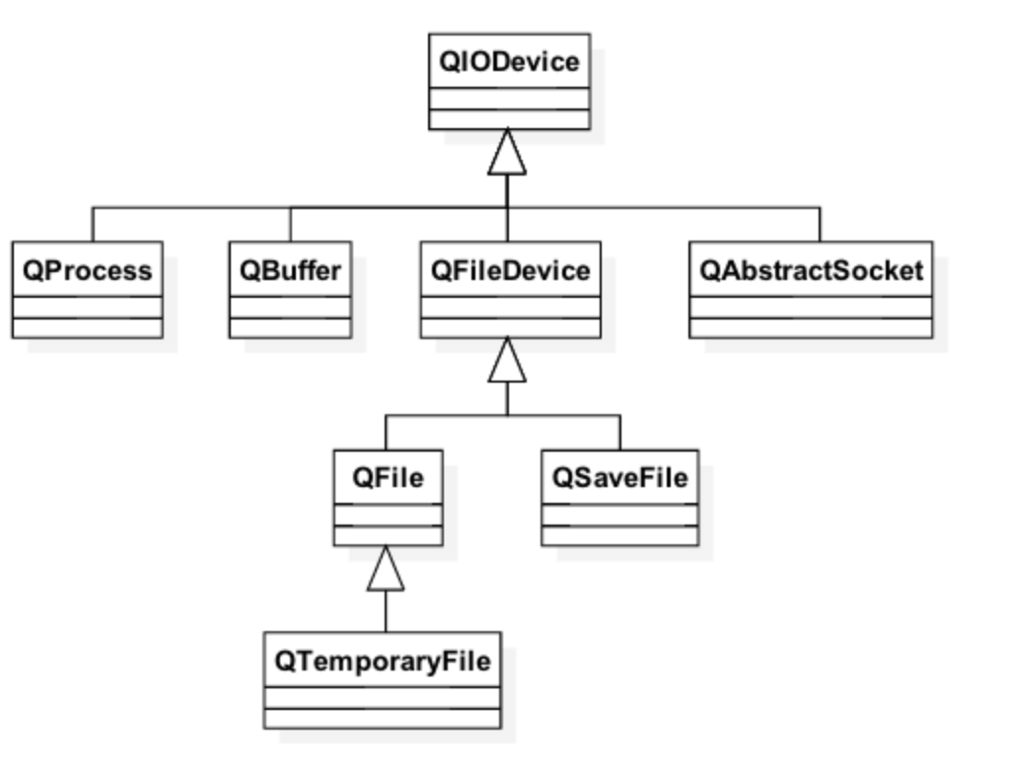
QIODevice
QFile, QBuffer, QUdpSocket, QTcpSocket, QNetworkReply, and QProcess all inherit from QIODevice
QIODevice is abstract
But often used in interfaces to provide device independent I/O features
Two types of devices distinguished
Random-access devices
Supports seeking to arbitrary positions using seek()
QFileDevice, QBuffer
Sequential devices
No seeking supported
QTcpSocket, QProcess

Slide 117
QIODevice Read and Write Functions
Variety of functions available
bool getChar(char *c), bool putChar(char c)
QByteArray readLine(qint64 maxSize)
qint64 read(char *data, qint64 maxSize)
qint64 write(const QByteArray *byteArray)
QByteArray readAll()
Position where data is written to or read from
Returned by qint64 pos()
qint64 bytesAvailable() returns bytes available after the position
Position may be changed with seek(qint64 pos) or reset()
bool atEnd() returns true in the end of the file

Slide 118
File I/O
QFile file("data.txt");
if (!file.open(QFile::ReadWrite | QIODevice::Text)) ; // Handle error
const auto fileSize(file.size());
QByteArray readBuffer; // Read file character by character
char c;
while (file.getChar(&c))
readBuffer.append(c);
// Read data by chunks
readBuffer.clear();
file.reset();
const int bufferSize(10); // Intentionally extremely small for demo purposes
char chunk[bufferSize];
auto readBytes(0);
while ((readBytes = file.read(chunk, bufferSize)) > 0)
readBuffer.append(chunk, readBytes);

Slide 119
Streaming
Data is often read and written using QDataStream or QTextStream
Add extra information about the data to the stream
Can operate with any QIODevice, a QByteArray or a QString
QTextSream
Convenient for reading and writing words, lines, and numbers
Commonly used to read console input and write to console output
Locale-aware
QDataStream
Portable between hardware architectures and operating systems
Format depends on the stream version used
Not human-readable
Complex types broken to primitive types, which are then serialized to the stream
© 2017 The Qt Company

Slide 120
Data Stream
Data data; // Custom assignable type, registered with the meta-type system
data.setString("Hello World");
data.setValue(42);
QTemporaryFile file;
if (!file.open()) { qDebug() << "Temp file opening failed."; return EXIT_FAILURE; }
QDataStream stream(&file);
// If a custom type is searilzed using QVariant,
// serialization operators need to be provided
#ifndef USE_VARIANT
stream << data;
#else
qRegisterMetaTypeStreamOperators<Data>("Data");
QVariant variantData(QVariant::fromValue(data));
stream << variantData;
#endif

Slide 121
Memory-Mapped Files
Data manipulated via a memory pointer
Changes stored into a file
Unless the file is open in mode: QFileDevice::MapPrivateOption
Memory keeps mapped, until unmapped or file object destroyed
if (!file.open(QFile::ReadWrite | QIODevice::Text))
; // Error handling
uchar *mappedPointer = file.map(0, file.size());
QByteArray array(reinterpret_cast<char *>(mappedPointer));
array.replace("Dickens", "DICKENS");
memcpy(mappedPointer, array.constData(), file.size());

Slide 122
Summary
Lab 3: Item Containers
QtCore is an essential Qt module, on which all other modules are dependent
It provides basic types, threads, item containers, streaming and many other features
QString provides a rich API to manipulate 16-bit Unicode characters
Characters are coded to strings using QCodec
QByteArray is a container of bytes
Qt provides its own item containers and iterators
For example, Q_FOREACH macro can be used to iterate a container or array as with C++ 11 range-loop

Slide 123
Thank you
NN@qt.io

